Slide 1
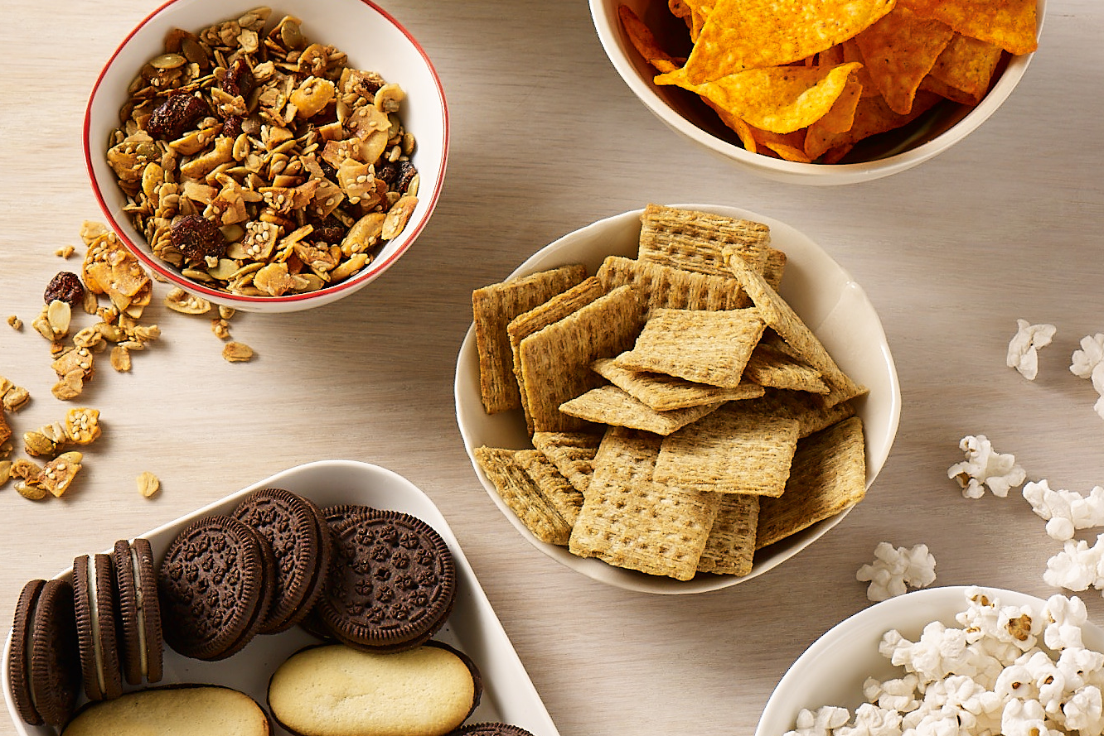

26 Years of
Consumer Research
The United Soybean Board tracking study is now in its 26th year
  1,000 consumers surveyed annually
Study measures attitudes about nutrition, soybean oil and strength of “U.S. grown” message
This presentation includes key findings from USB’s 2019 Consumer Insights Annual Survey. For the full survey results, visit SoyConnection.com.

Slide 2


High Value Placed on
U.S. Grown Crops & Health
Consumers express a strong preference (63%)
for buying a product labeled as made with 100% U.S. grown ingredients over one that does not contain this label
The majority (73%) of consumers said supporting domestic agriculture
by buying foods produced with crops grown by U.S. farmers is important
Consumers (65%) are willing to pay more
for healthy or healthier versions of foods than they already consume

Slide 3
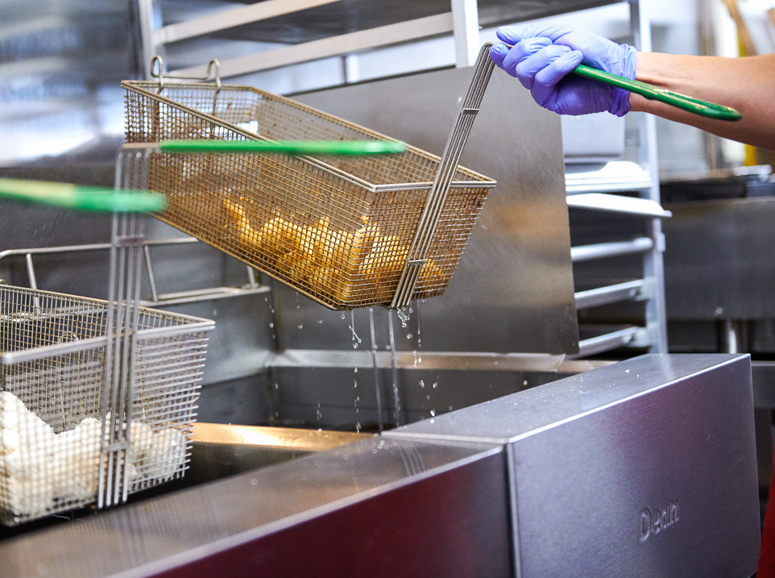
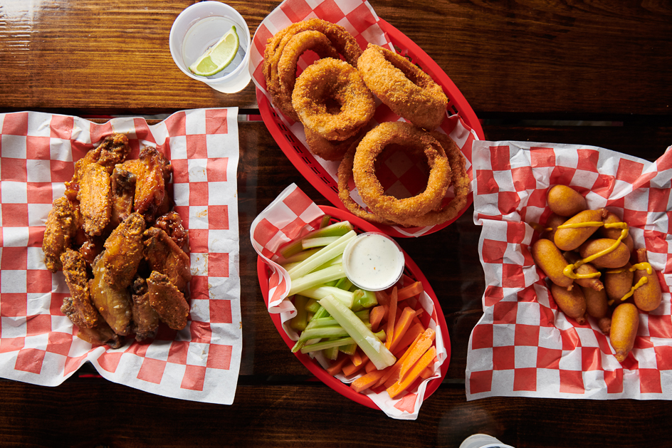
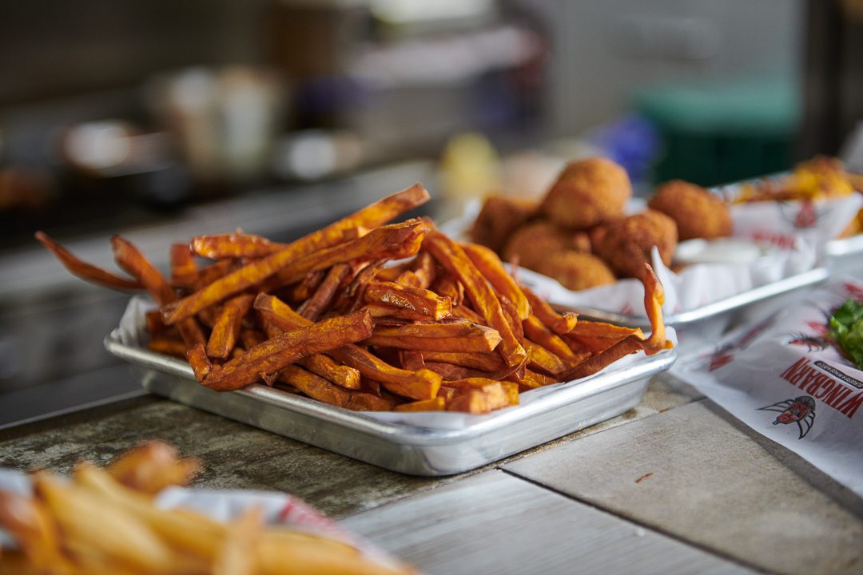
Consumers Care about the Type of Oil Used in Restaurants
75%
of customers are interested in the type of oil used in restaurants for frying or for preparing foods such as salad dressings
The majority say they would be more likely to eat at a restaurant using oils lower in saturated fats

Slide 4
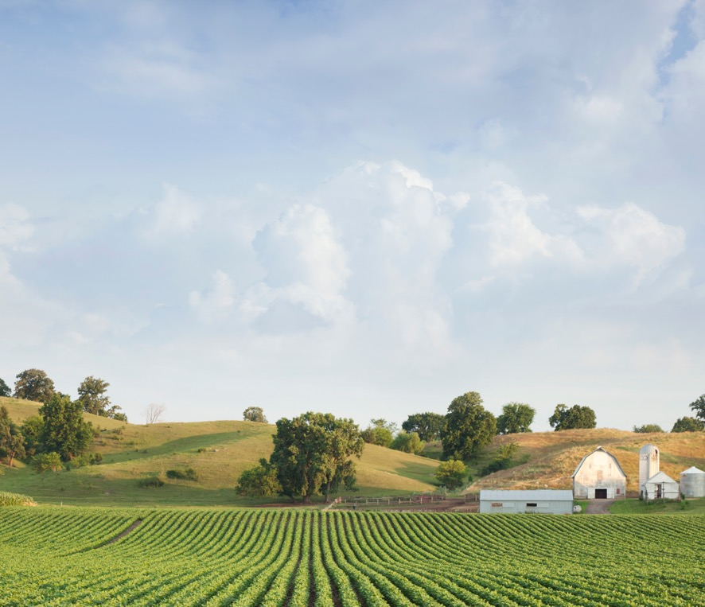

Positive Associations with Soy
Characteristics consumers associate with soybean oil most often is
While palm oil has highest associations with
“100% U.S. grown” and “grown sustainably by U.S. farmers”
“harvested outside the U.S.”
and
“contributes to deforestation/loss of habitat.”

Slide 5
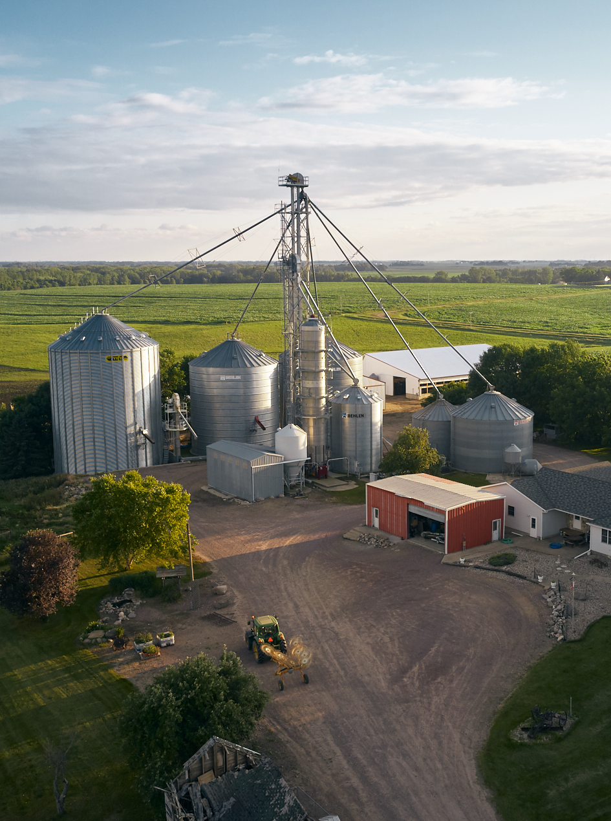
Sustainable Farming
In 2019, awareness of U.S. grown soybeans as a sustainable crop jumped to
Over half of consumers
62%
48%
say they would be more likely to buy U.S. grown soybean oil in the future after learning this information.
Just under six in ten
Among those familiar with the term, nearly
59%
80%
are now aware of the term “sustainable farming,”.
say it is important.
About three-quarters
73%
say eating foods produced by sustainable practices is important to them.

Slide 6
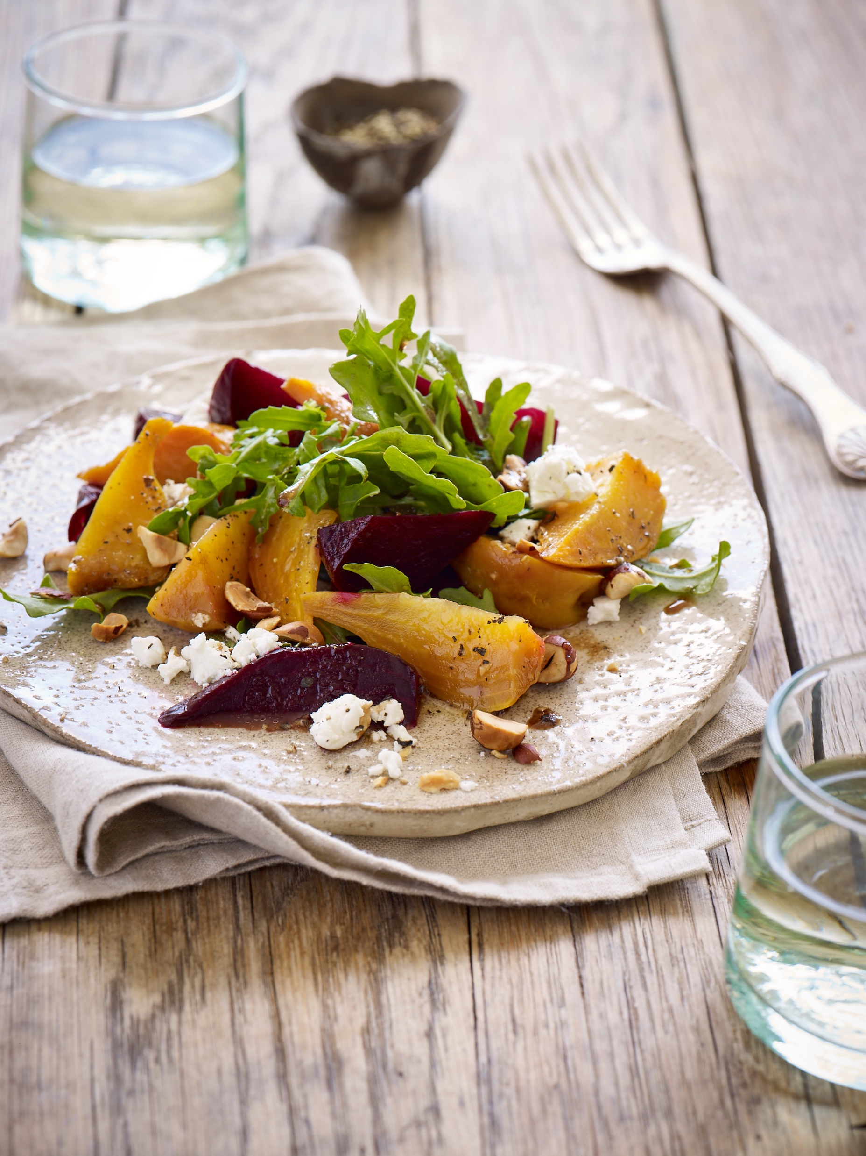
Healthy Living Matters
Consumers continue to view soybean oil as generally healthy.
While palm oil is increasingly being used in packaged food products, consumers consistently perceive it to be less healthy than soybean oil.
In 2019
66%
of respondents with an opinion view soybean oil as healthy compared with 43% who view palm oil as healthy.

Slide 7
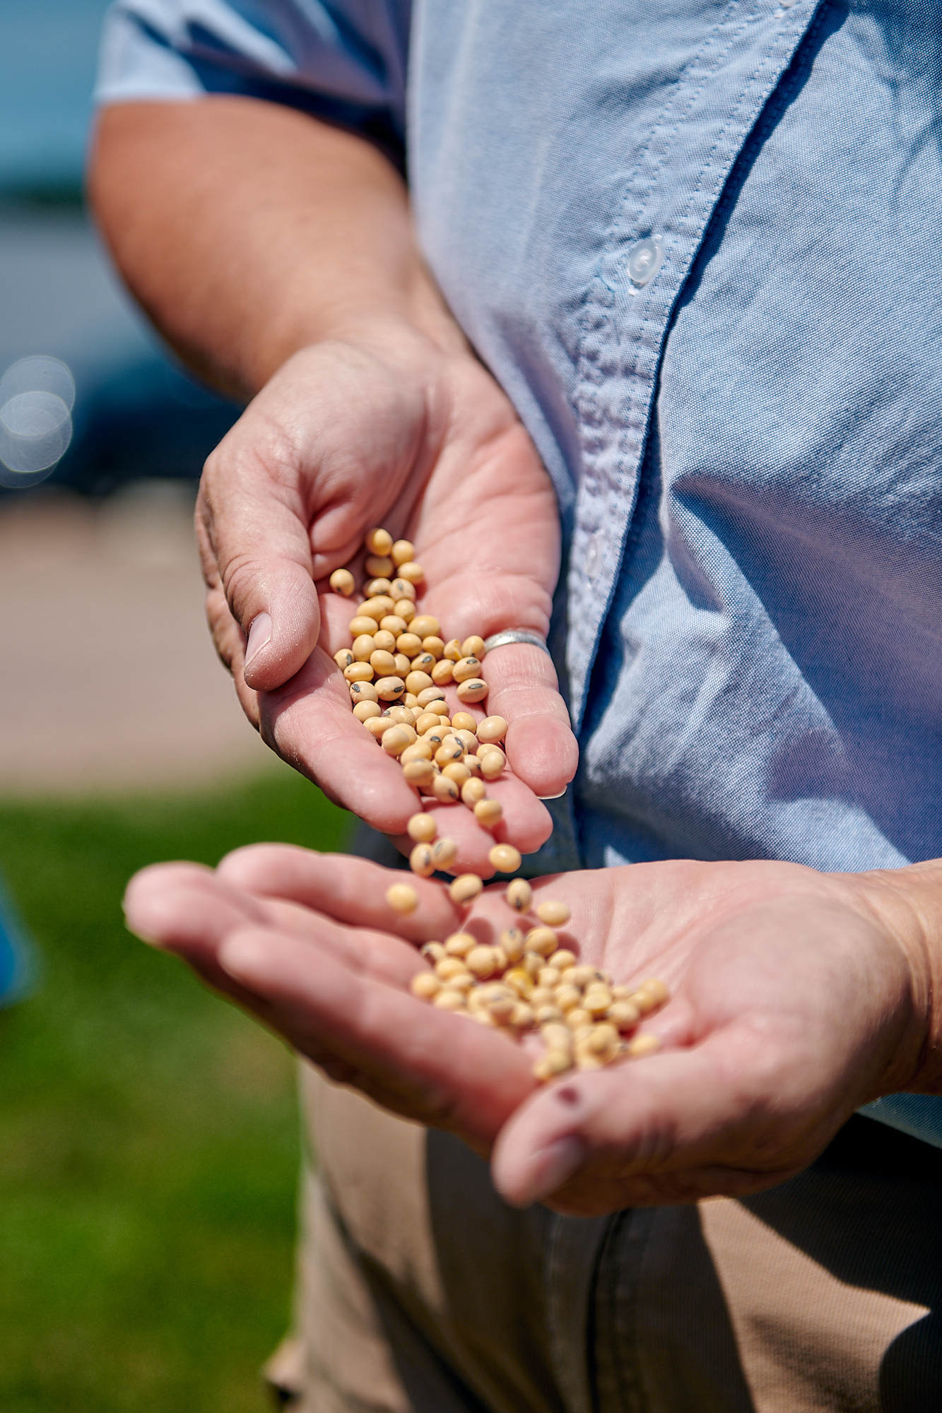
Labeling
40%
of consumers say that vegetable oil is “healthier than they thought”
41%
say they would be more likely to buy vegetable oil labeled as 100% U.S. grown soybean oil.
Providing information that soybean oil is “heart healthy” is even more motivating, with 62% of consumers more likely to purchase 100% U.S. grown soybean oil with this additional claim.

